Slide 1

Web Interface for Customer Registration

Slide 2
Home Page for Customer Registration Process

Slide 3

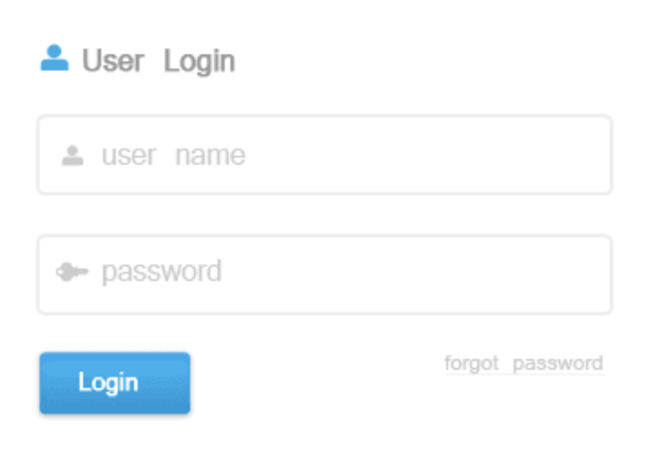
You are :
Customer
1st Approver
2nd Approver
Customer Registration

Slide 4
Button Action – Home Page
Customer
Login User and Password is disable
1st Approver
Login User and Password is enabled
2nd Approver
Login User and Password is enabled
Login Button
If ”Customer” option picked, open ”Registration Request” Page
If ”1st Approver” option picked, open ”1st Approver” Page
If ”2nd Approver” option picked, open ”2nd Approver” Page
Mule Anypoint
Publish Message to “Registration” Queue
Subscribe Message from “Registration” Queue

Slide 5
If you are ”Customer”

Slide 6


Requestor Name :
Registration
Request
Request Date :
Reason :
OK
Cancel

Slide 7
Button Action – Registration Request
OK
API will Publish a message into “Reg_Request” Queue with fields including Requestor Name , Request Date, Request Comment
Cancel
Just quite the application
Mule Anypoint
Publish Message to “Registration” Queue
Subscribe Message from “Registration” Queue

Slide 8
If you are ”1st Approver”

Slide 9
First Approver
Requestor Name :
Request Date :
Request Reason :
1st Approver Comment :
Get Next
Approve
Reject

Slide 10
Button Action – 1st Approver
Get Next
API will Subscribe a message from “Reg_Request” Queue in Solace
Display Requestor Name, Request Date, Request Comment
Approve
API will Publish a message into “First_Approved” Queue with fields including Requestor Name , Request Date, Request Comment and 1st Approver Comment
Reject
API will Publish a message into “Request_Reject” Queue with fields including Requestor Name, Request Date, Request Comment and 1st Approver Comment
Mule Anypoint
Publish Message to “Registration” Queue
Subscribe Message from “Registration” Queue

Slide 11
If you are ”2st Approver”

Slide 12
First Approver
Requestor Name :
Request Date :
Request Reason :
1st Approver Comment :
2nd Approver Comment :
Get Next
Approve
Reject

Slide 13
Button Action – 2nd Approver
Get Next
API will Subscribe a message from “First_Approved” Queue in Solace
Display Requestor Name, Request Date, Request Comment and 1st Approver Comment
Approve
API will Publish a message into “Second_Approved” Queue with fields including Requestor Name
After then, API will subscribe a message from “Second_Approved” Queue, then invoke Solace SEMP API to perform
Create User Profile
Create Queue
Grant ACL
Reject
API will Publish a message into “Request_Reject” Queue with fields including Requestor Name, Request Date, Request Comment and 1st Approver Comment
Mule Anypoint
Publish Message to “Registration” Queue
Subscribe Message from “Registration” Queue

